Slide 1
Welcome to Jupyter
DATA SCIENCE 101 — LESSON 03
Introduction to Jupyter Notebook: what it is, how to install it with Anaconda, and how to work faster with shortcuts.
Heng Somoradane
Notes:
Source page 1.

Slide 2
What Will We Cover?
TODAY'S AGENDA
What is Jupyter Notebook / JupyperLab?
Understand different between Python and the Jupyter Notebook App.
How to use Jupyter
A tour of the dashboard, notebooks, cells, and the difference between edit and command mode.
Shortcuts consumption
Work faster with keyboard shortcuts: cut/copy/paste cells, add/delete cells, and markdown cells.
Insight: Along the way: coding techniques — solving error messages and starting with a clean slate.
Notes:
Source pages 3–4.

Slide 3

A Server–Client Application
WHAT IS JUPYTER
The Jupyter Notebook App (or simply Jupyter) is a server–client application.
You type code on your machine, the Jupyter server runs it through Python, and the results render right back in your browser.
Insight: Notebook files are saved in the IPython Notebook format — *.ipynb for brief.
Notes:
Source pages 2, 22.

Slide 4
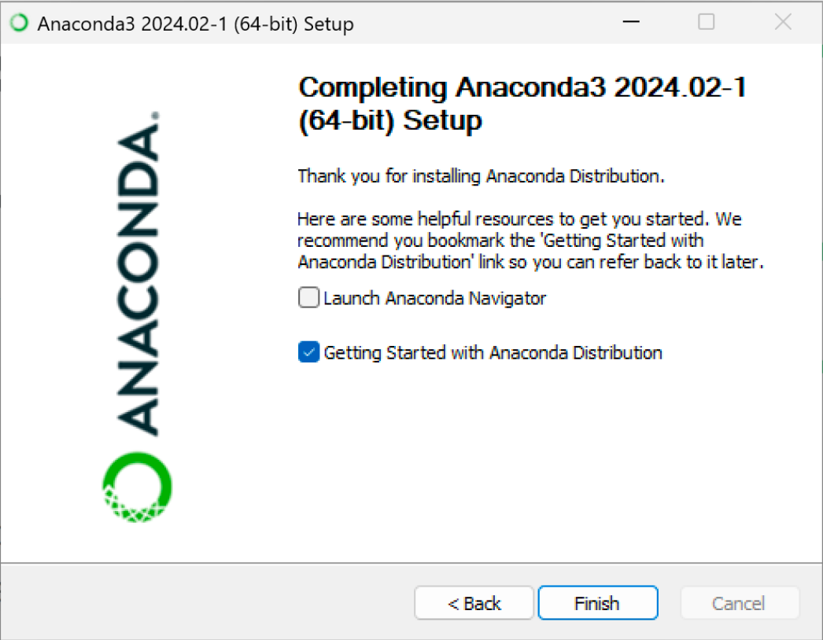
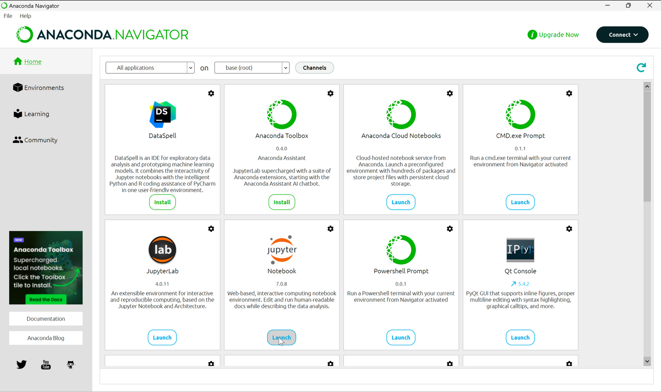
Finish and Launch
INSTALLATION — STEP 4 OF 4
Untick the extras.
Click Next → Finish; you can untick all selections on the last screen.
Find Anaconda Navigator in the Start menu and press Launch on the Jupyter Notebook tile (or open Jupyter Notebook directly).
Notes:
Source pages 14–18. Browser choice (page 19): pick Chrome + Always.

Slide 5
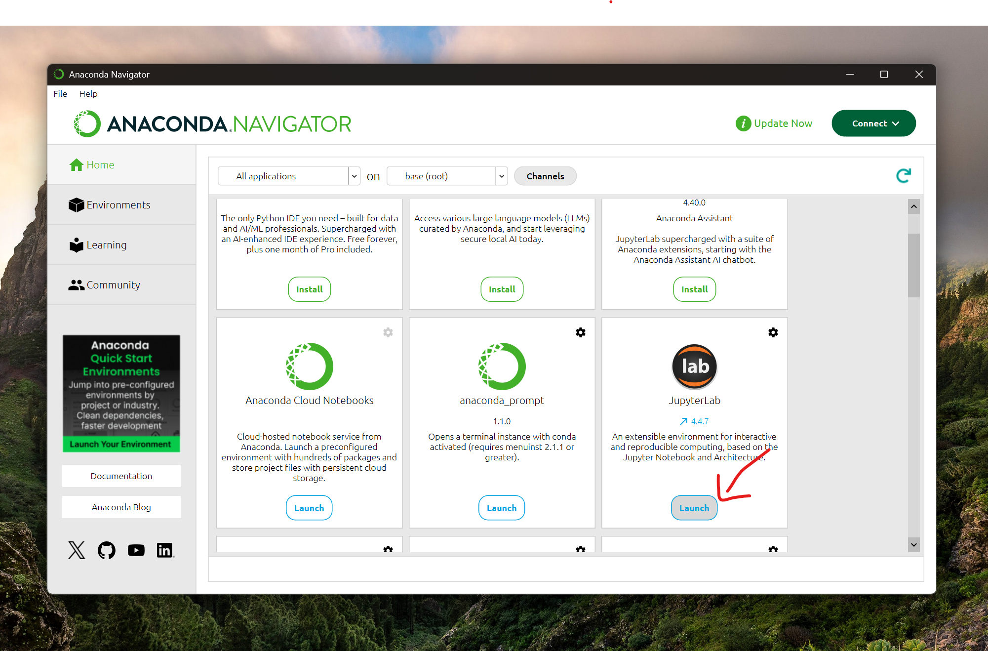
Open Anaconda

Slide 6
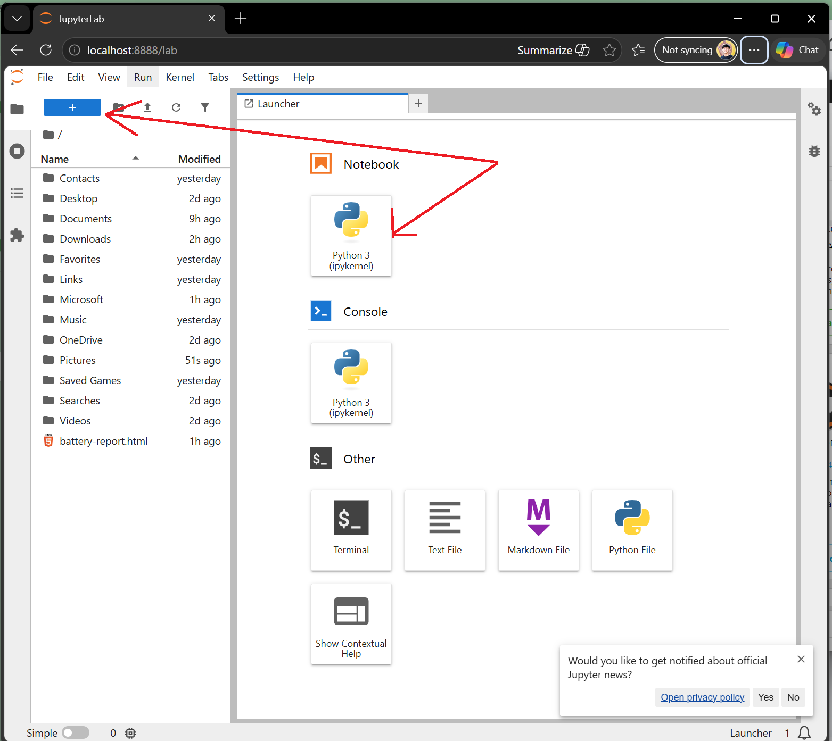
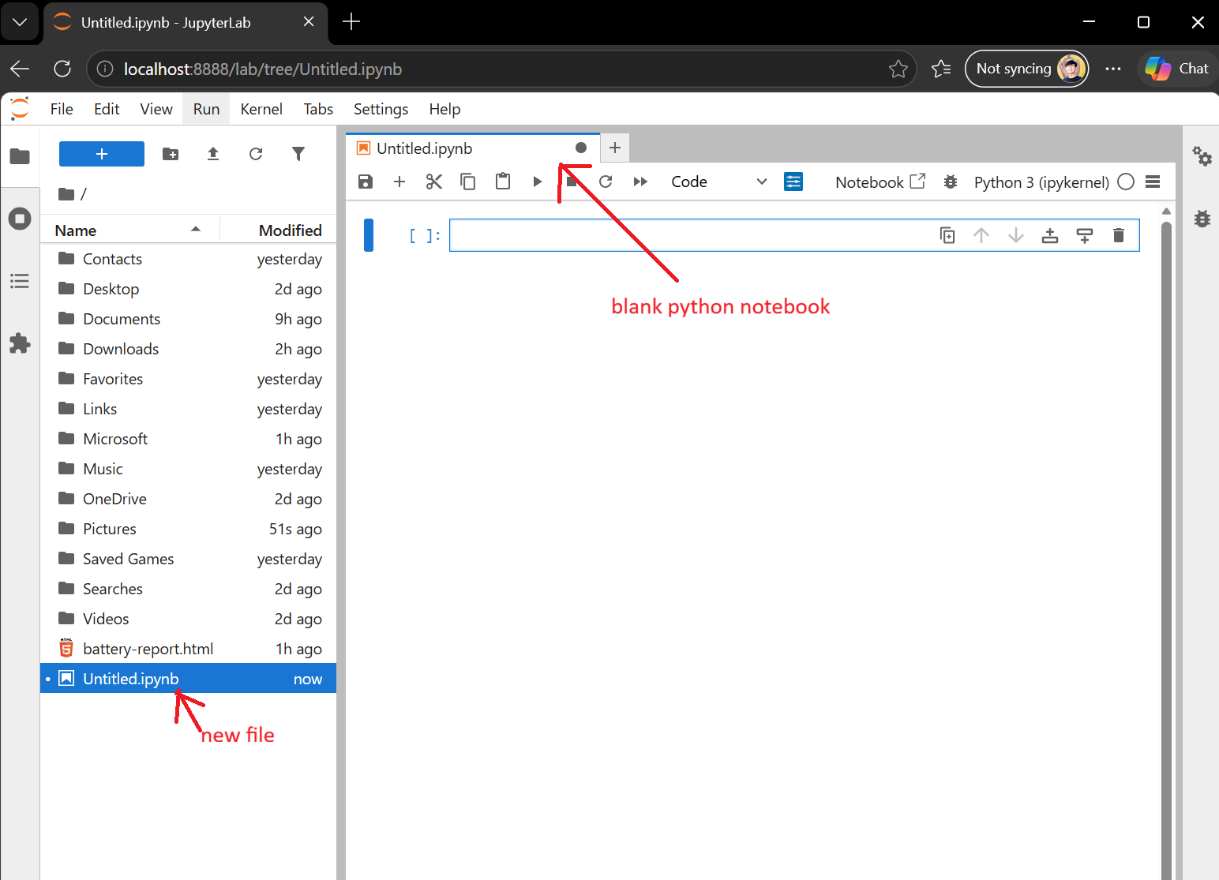
Open and Create Notebook

Slide 7
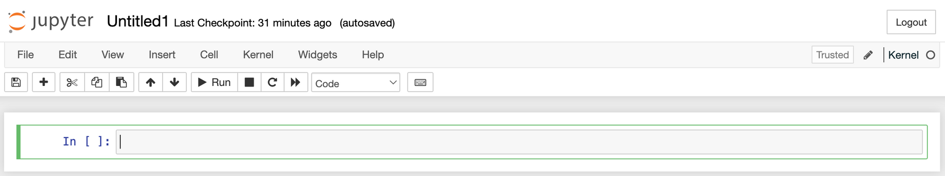
Cells: Edit vs Command Mode
A TOUR OF JUPYTER
The gray box is the input field.
Press Enter to enter edit mode — a green border appears and you can type.
Press Escape to return to command mode — the border turns blue and keys become shortcuts.
Notes:
Source pages 23–24.

Slide 8
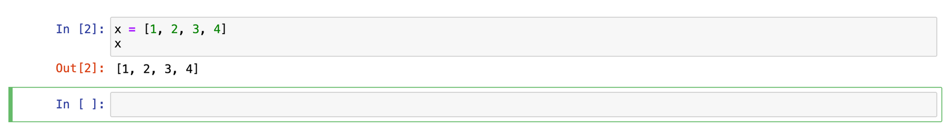
Execute Cells
RUNNING CODE
Ctrl+Enter vs Shift+Enter.
Type x = [1, 2, 3, 4] then x, and press Ctrl + Enter to execute in place.
Press Shift + Enter to execute and create a new cell below at the same time.
Notes:
Source page 25.

Slide 9
Command-Mode Shortcuts
SHORTCUTS CONSUMPTION
Cut, copy, paste cells
X cuts the selected cell, C copies it, V pastes it below the selected cell.
Add cells
A inserts an empty cell above the selection; B inserts one below.
Delete cells
Press D twice to delete the selected cell — handy when you've made a mistake.
Markdown vs code
M turns a cell into markdown (documentation, not executed); Y turns it back into a code cell.
Notes:
Source pages 26–36.

Slide 10
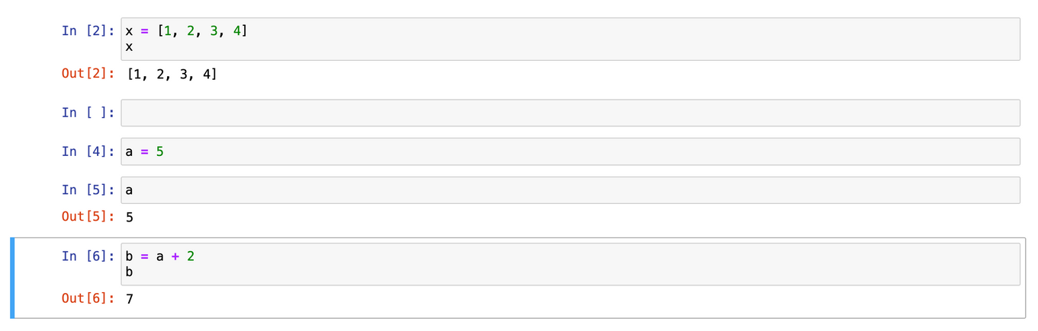
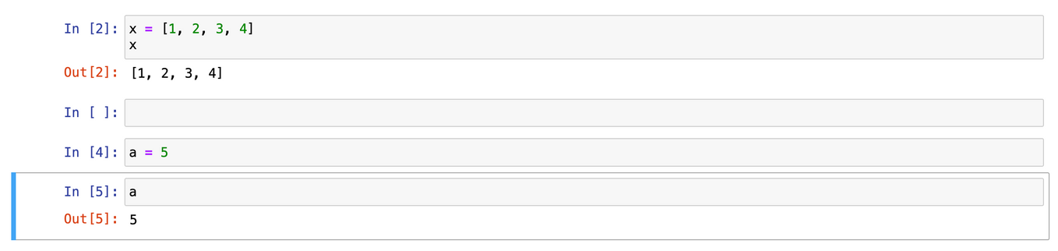
Example: Move a Cell with X and V
SHORTCUTS IN PRACTICE
Select, cut, move, paste.
Select the b = a + 2 cell and press X to cut it.
Move up to the target cell and press V — the cell is pasted below it.
Only the toolbar arrow buttons move cells directly; there's no shortcut for that.
Insight: In command mode, press H to see the full keyboard-shortcuts reference.
Notes:
Source pages 27–30, 37.

Slide 11
The Benefits
WHY JUPYTER
Documentation next to code
When code gets long, markdown cells let you leave comments and explain the solution you've created.
Run any cell, any time
Select and execute whichever cell you want — solve problems in pieces.
Coding techniques
Read error messages (like NameError) to fix bugs, and restart the kernel to start with a clean slate.
Insight: Practice the shortcuts this week — they quickly become muscle memory.
Notes:
Source pages 4, 36.

